Slide 1


HACKING

Slide 2
Tales from the Crypt.
Practical Applications & Lessons Learned.

Slide 3
GRADES
… Why?
It’ll be fine..
Just enter the Navy.
They don’t care, right?

Slide 4


Slide 5
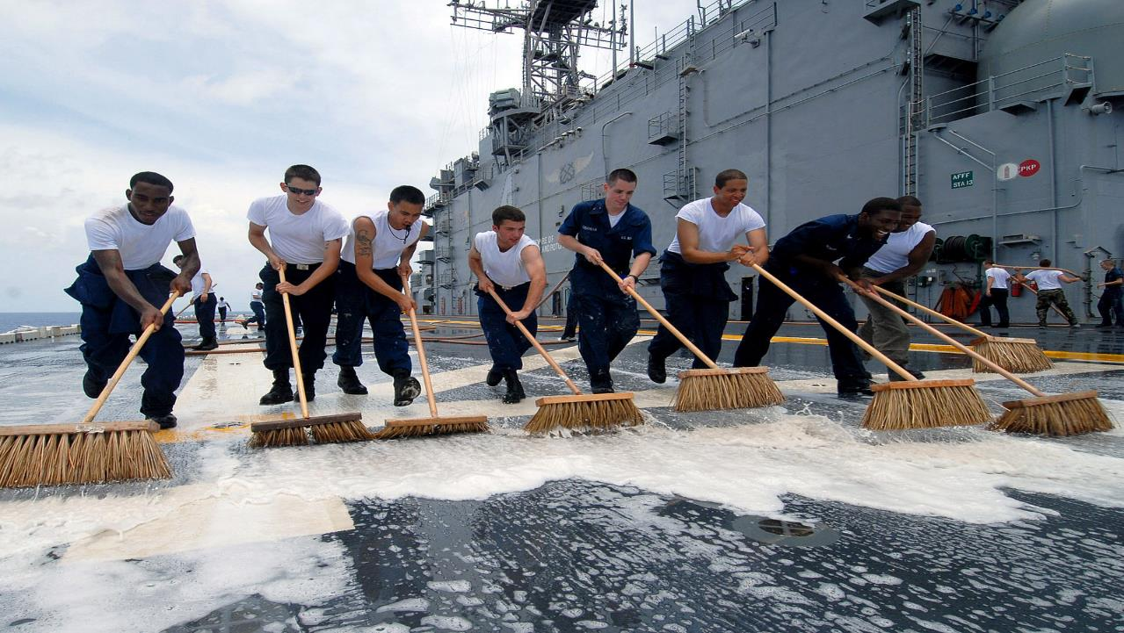
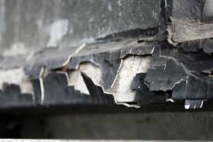
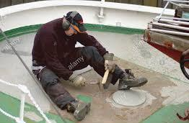

Slide 6
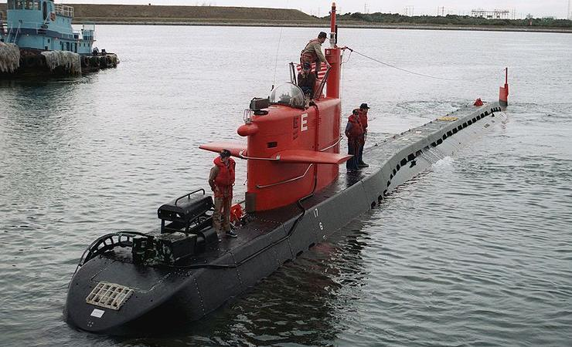
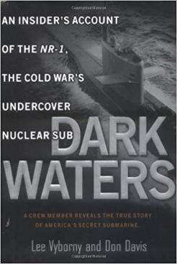
Submarine NR-1
12 Man Crew
Nuclear Powered
Deep Submersible

Slide 7

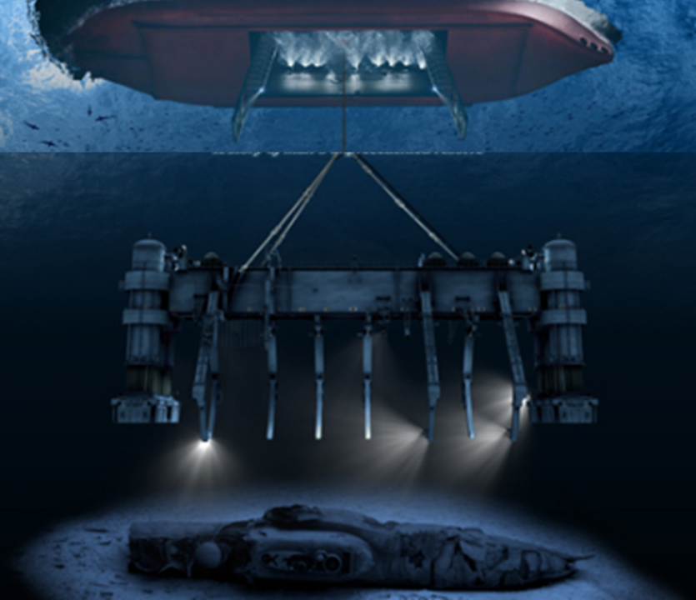
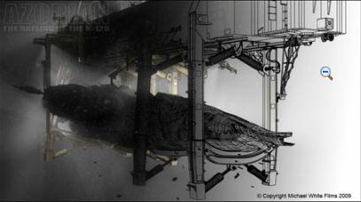

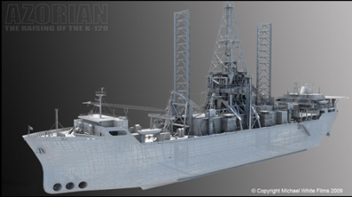
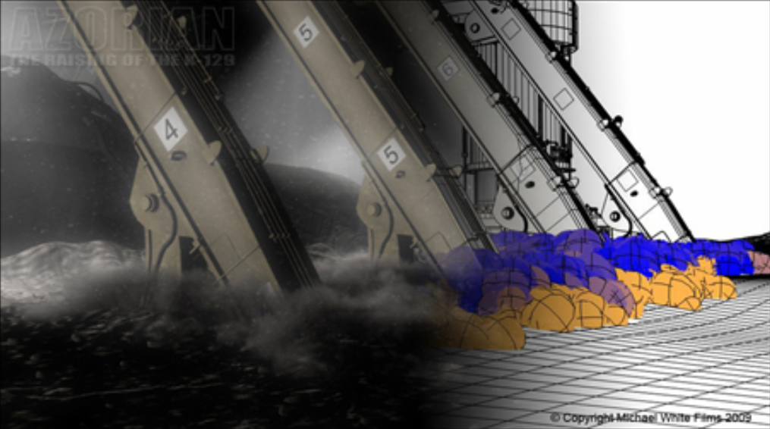
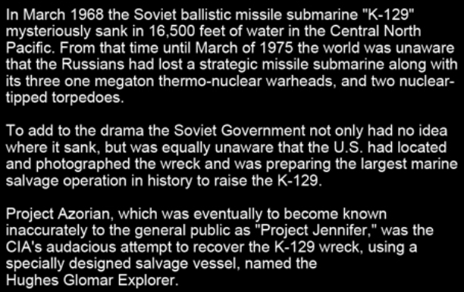
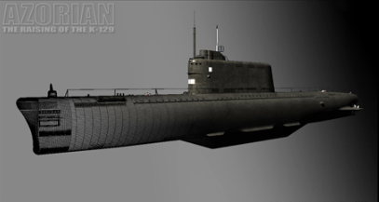
WHY DO YOU CARE?
Images Source: http://www.white.at/projectjennifer/images/forumad/Azorian_forumad.jpg
Notes:
To this day, Project Azorian is the deepest ocean salvage operation ever attempted and challenged a team of Americas elite marine and aero-space companies to design a unique system to solve an incredible problem, how do you lift to the surface a damaged 1,700 ton segment of submarine from a depth of 3 miles while being observed by a paranoid and well-armed Soviet intelligence organization?

Slide 8
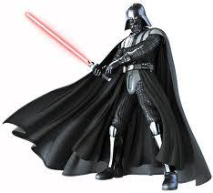
Exploring THE DARK SIDE

Slide 9
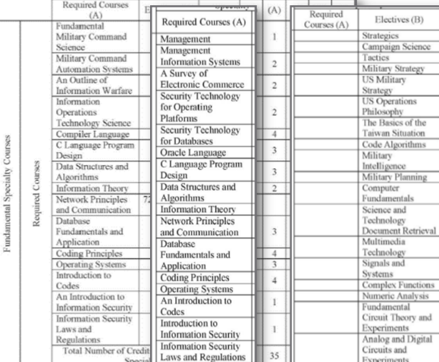
Information Warfare (IW)
IW is not a distinct type of warfare but exists in different forms.
IW can be applied at every level of war, across all phases of an operation, and encompasses the entire range of military operations.
Seven forms of IW:
Command & Control Warfare (C2W)
Electronic Warfare (EW)
Cyber Warfare (Cyber W)
Network Centric Warfare ( NCW)
Intelligence Based Warfare (IBW)
Psychological Warfare (PSYWAR)
Economic Information Warfare (EIW)

Slide 10
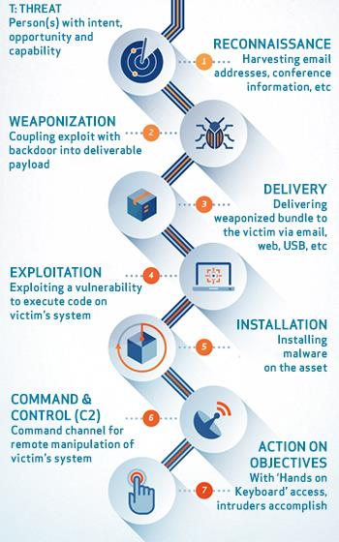
CYBER KILL CHAIN
1. Reconnaissance
2. Weaponization
3. Delivery
4. Exploitation
5. Installation
6. Command and Control
7. Actions on Objectives

Slide 11
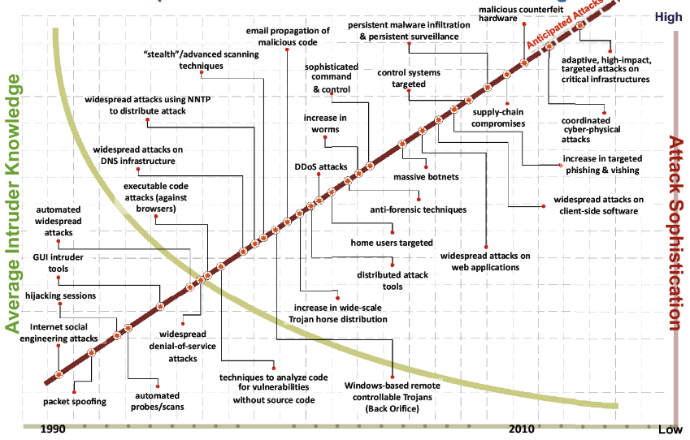

This is what drives the need for Security.
Attack Sophistication vs. Knowledge
INTELLIGENCE AND NATIONAL SECURITY ALLIANCE
INSA CYBER INTELLIGENCE TASK FORCE
1990
2000
2010
Notes:
We all know this. This happens to be an effective graphic to help illustrate the problem. The situation is that cyber attacks continue to increase in effectiveness because of multiple variables. The question is what is it that you can do to enable your business to meet your compliance objectives, manage risk, and effectively govern your infrastructure?
//
Source:
INTELLIGENCE AND NATIONAL SECURITY ALLIANCE
INSA CYBER INTELLIGENCE TASK FORCE
OCTOBER 2014

Slide 12
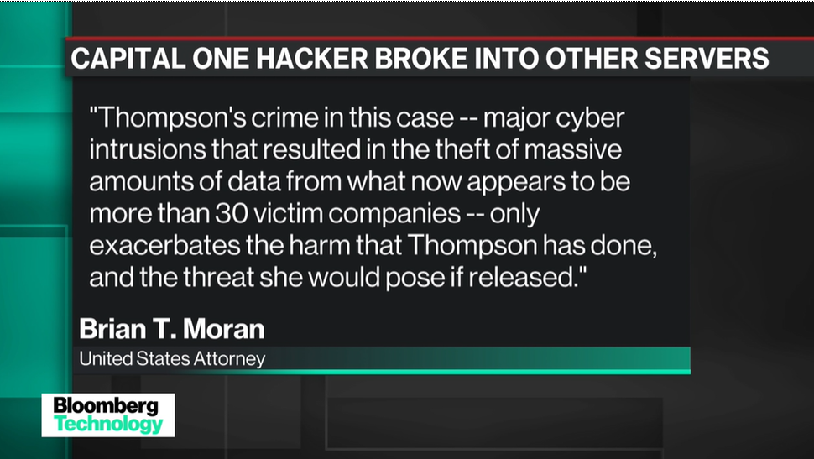
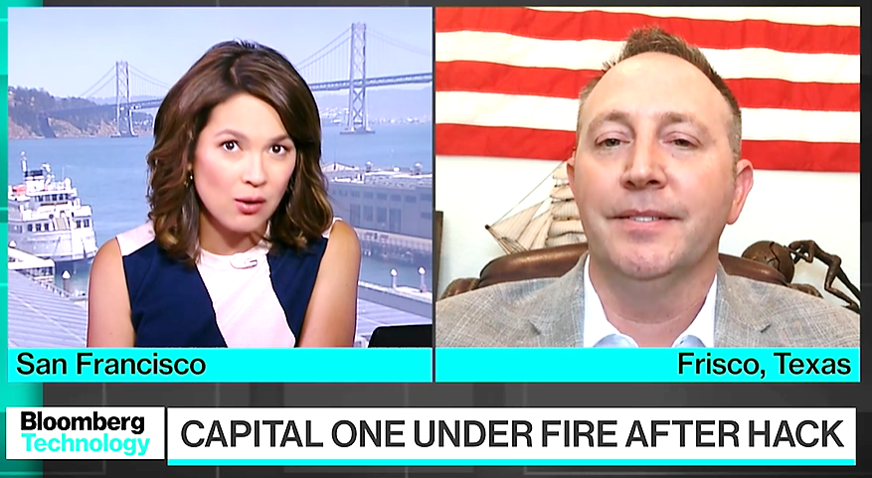
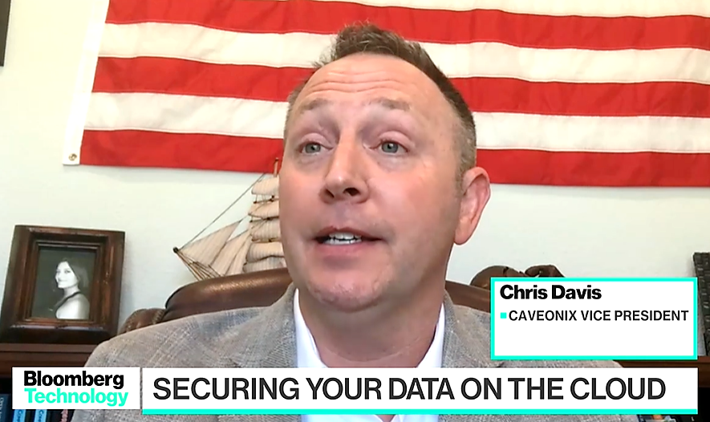
Capital One Breach

Slide 13
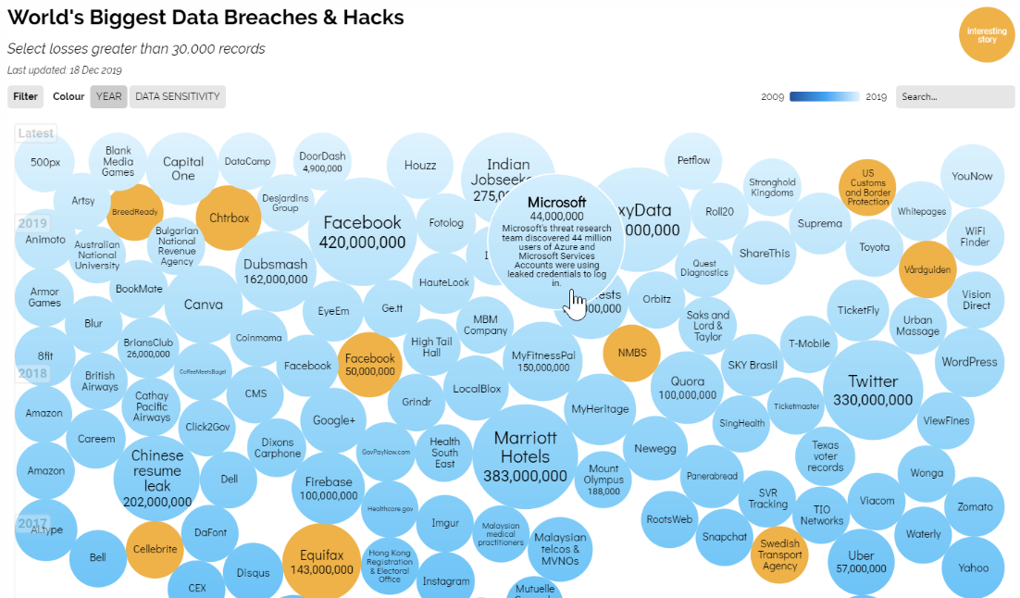
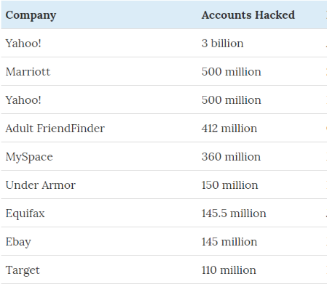
2019
2018
2017

Slide 14




Cybercrime is more profitable than the global illegal drug trade.
Estimated $6 trillion in damages by 2021 exceeds the global trade of illegal drugs.
$76 billion of illegal activities involves bitcoin.
Only 10% of cybercrimes are reported in the U.S each year.
$300 billion cyber security market.
Ransomware attack every 14 seconds.
300,000 new malware is created every day.
You can become an American citizen for $6,000.
Hackers steal 75 records every second.
There are over 715,000 cybersecurity experts employed in the US alone.
There will be 3.5 million cybersecurity jobs openings in 2021.

Slide 15
Data Breach Sources
Open Security Foundation: datalossdb and osvdb (http://www.opensecurityfoundation.org/ )
Computer Security Institute (CSI): http://gocsi.com/
Office of Inadequate Security: http://www.databreaches.net/
Identity Theft Resource Center: http://www.idtheftcenter.org/
ISACA: www.isaca.org
ISSA: www.issa.org
Mitre Corporation: www.mitre.org
OWASP: http://owasp.com/index.php/Main_Page
Privacy Rights Clearing House: http://www.privacyrights.org/
SANS: www.sans.org
The Ponemon Institute: www.ponemon.org
www.databreachcalculator.com.

Slide 16
FINAL THOUGHTS

Slide 17


Slide 18
GRADES
… Why?
Knowledge.
WHY DO YOU CARE?
-- Take Ownership. Do the work.
-- It’s Your Decision.
-- Think Long Term.
-- Become the Best Version of Yourself.

Slide 19
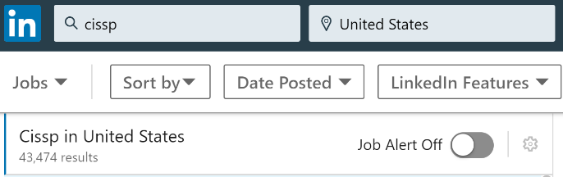
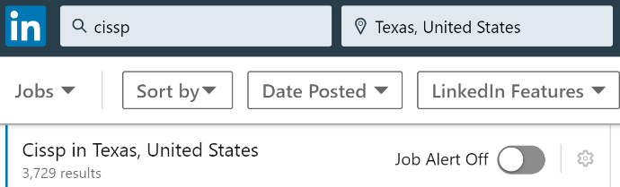
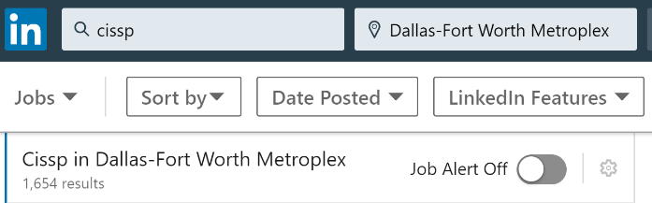
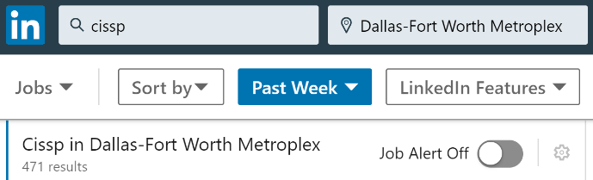
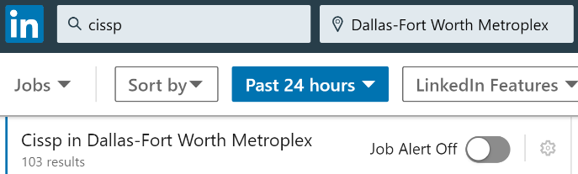

PAYOFF.

Slide 20

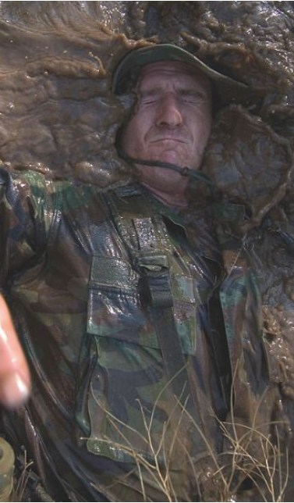

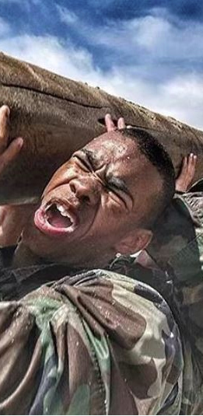
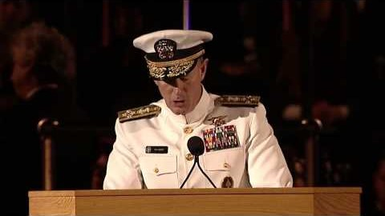

If you want to change the world, don't ever, ever ring the bell.

Slide 21


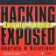



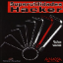
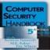
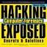
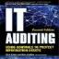
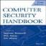


Chris Davis
Shout Outs
All the hackers that went before me.

Slide 22
Additional Materials

Slide 23
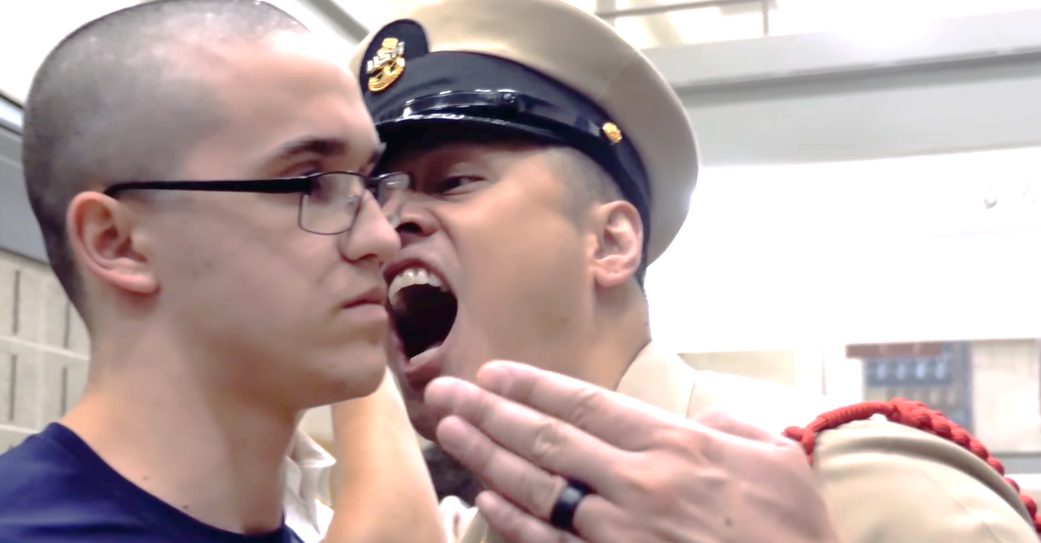

Slide 24
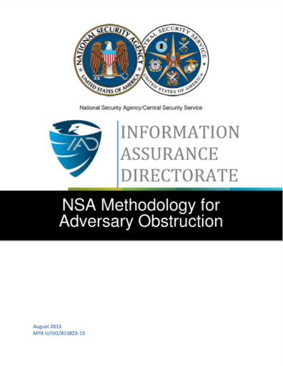
https://www.nsa.gov/ia/_files/factsheets/NSA_Methodology_for_Adversary_Obstruction.pdf

Slide 25
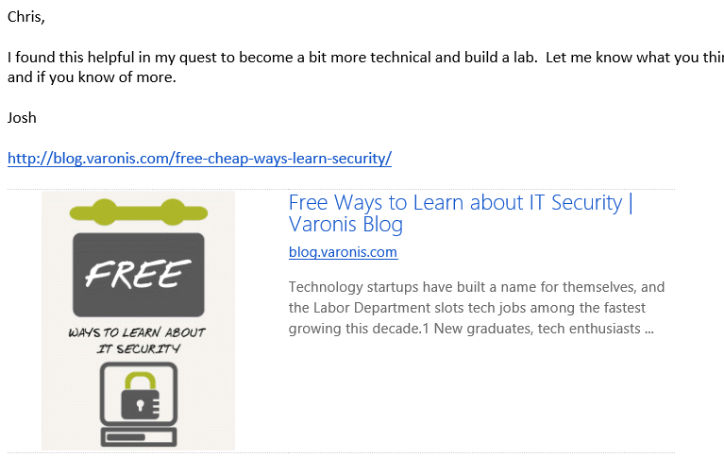

Slide 26
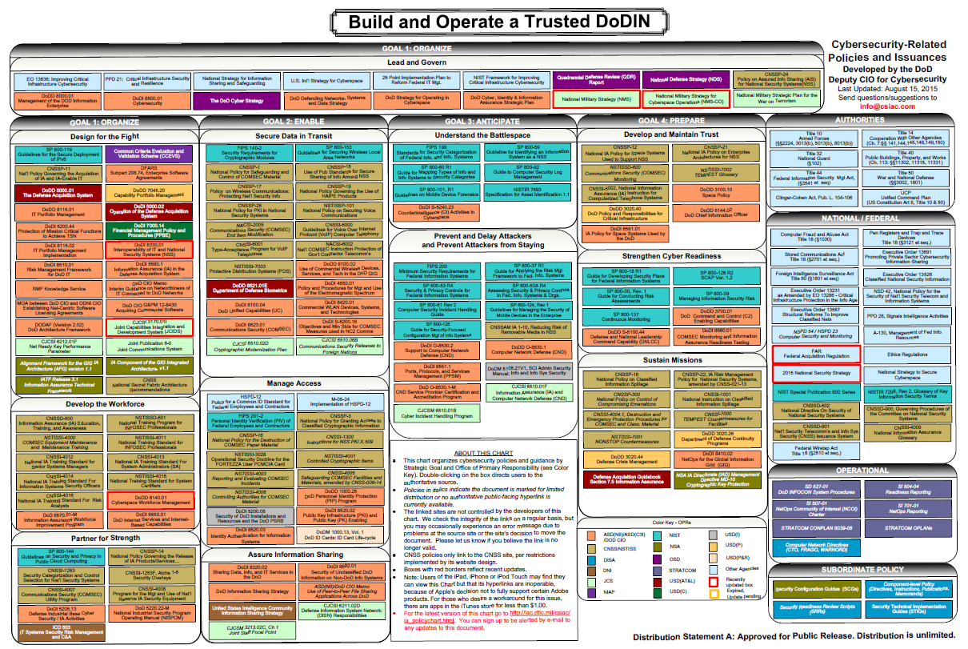
http://iac.dtic.mil/csiac/ia_policychart.html

Slide 27
Intrusion Kill Chain
1. Reconnaissance - Research, identification and selection of targets, often represented as crawling Internet websites such as conference proceedings and mailing lists for email addresses, social relationships, or information on specific technologies.
2. Weaponization - Coupling a remote access Trojan with an exploit into a deliverable payload, typically by means of an automated tool (weaponizer). Increasingly, client application data files such as Adobe Portable Document Format (PDF) or Microsoft office documents serve as the weaponized deliverable.
3. Delivery - Transmission of the weapon to the targeted environment. The three most prevalent delivery vectors for weaponized payloads by APT actors, as observed by the Lockheed Martin Computer Incident Response Team (LM-CIRT) for the years 2004-2010, are email attachments, websites, and USB removable media.
4. Exploitation - After the weapon is delivered to victim host, exploitation triggers intruders' code. Most often, exploitation targets an application or operating system vulnerability, but it could also more simply exploit the users themselves or leverage an operating system feature that auto-executes code.
Notes:
1. Reconnaissance - Research, identification and selection of targets, often represented as crawling
Internet websites such as conference proceedings and mailing lists for email addresses, social
relationships, or information on specific technologies.
2. Weaponization - Coupling a remote access trojan with an exploit into a deliverable payload,
typically by means of an automated tool (weaponizer). Increasingly, client application data files such
as Adobe Portable Document Format (PDF) or Microsoft office documents serve as the weaponized
deliverable.
3. Delivery - Transmission of the weapon to the targeted environment. The three most prevalent
delivery vectors for weaponized payloads by APT actors, as observed by the Lockheed Martin
Computer Incident Response Team (LM-CIRT) for the years 2004-2010, are email attachments,
websites, and USB removable media.
4. Exploitation - After the weapon is delivered to victim host, exploitation triggers intruders' code.
Most often, exploitation targets an application or operating system vulnerability, but it could also
more simply exploit the users themselves or leverage an operating system feature that auto-executes
code.
5. Installation - Installation of a remote access trojan or backdoor on the victim system allows the
adversary to maintain persistence inside the environment.
6. Command and Control (C2) - Typically, compromised hosts must beacon outbound to an
Internet controller server to establish a C2 channel. APT malware especially requires manual
interaction rather than conduct activity automatically. Once the C2 channel establishes, intruders
have "hands on the keyboard" access inside the target environment.
7. Actions on Objectives - Only now, after progressing through the first six phases, can intruders
take actions to achieve their original objectives. Typically, this objective is data exfiltration which
involves collecting, encrypting and extracting information from the victim environment; violations
of data integrity or availability are potential objectives as well. Alternatively, the intruders may
only desire access to the initial victim box for use as a hop point to compromise additional systems
and move laterally inside the network.

Slide 28
Intrusion Kill Chain
5. Installation - Installation of a remote access trojan or backdoor on the victim system allows the adversary to maintain persistence inside the environment.
6. Command and Control (C2) - Typically, compromised hosts must beacon outbound to an Internet controller server to establish a C2 channel. APT malware especially requires manual interaction rather than conduct activity automatically. Once the C2 channel establishes, intruders have "hands on the keyboard" access inside the target environment.
7. Actions on Objectives - Only now, after progressing through the first six phases, can intruders take actions to achieve their original objectives. Typically, this objective is data exfiltration which involves collecting, encrypting and extracting information from the victim environment; violations of data integrity or availability are potential objectives as well. Alternatively, the intruders may only desire access to the initial victim box for use as a hop point to compromise additional systems and move laterally inside the network.
Notes:
1. Reconnaissance - Research, identification and selection of targets, often represented as crawling
Internet websites such as conference proceedings and mailing lists for email addresses, social
relationships, or information on specic technologies.
2. Weaponization - Coupling a remote access trojan with an exploit into a deliverable payload,
typically by means of an automated tool (weaponizer). Increasingly, client application data files such
as Adobe Portable Document Format (PDF) or Microsoft office documents serve as the weaponized
deliverable.
3. Delivery - Transmission of the weapon to the targeted environment. The three most prevalent
delivery vectors for weaponized payloads by APT actors, as observed by the Lockheed Martin
Computer Incident Response Team (LM-CIRT) for the years 2004-2010, are email attachments,
websites, and USB removable media.
4. Exploitation - After the weapon is delivered to victim host, exploitation triggers intruders' code.
Most often, exploitation targets an application or operating system vulnerability, but it could also
more simply exploit the users themselves or leverage an operating system feature that auto-executes
code.
5. Installation - Installation of a remote access trojan or backdoor on the victim system allows the
adversary to maintain persistence inside the environment.
6. Command and Control (C2) - Typically, compromised hosts must beacon outbound to an
Internet controller server to establish a C2 channel. APT malware especially requires manual
interaction rather than conduct activity automatically. Once the C2 channel establishes, intruders
have "hands on the keyboard" access inside the target environment.
7. Actions on Objectives - Only now, after progressing through the first six phases, can intruders
take actions to achieve their original objectives. Typically, this objective is data exfiltration which
involves collecting, encrypting and extracting information from the victim environment; violations
of data integrity or availability are potential objectives as well. Alternatively, the intruders may
only desire access to the initial victim box for use as a hop point to compromise additional systems
and move laterally inside the network.

Slide 29
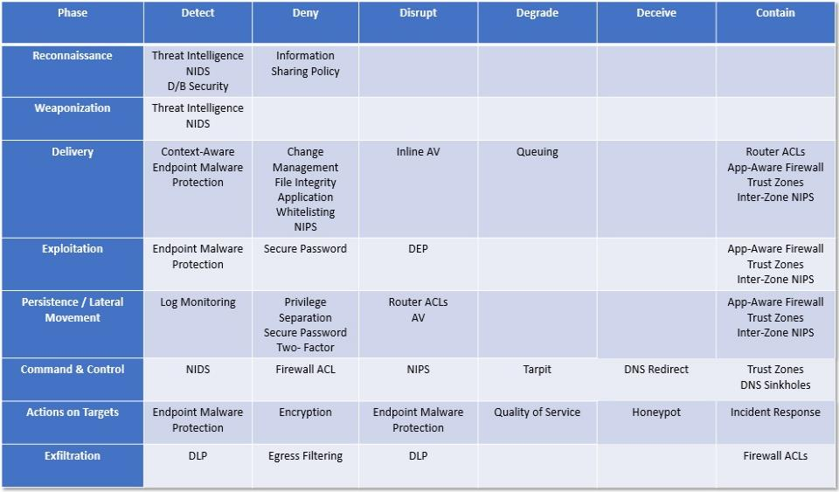
Courses of Action
Notes:
3.3 Courses of Action
The intrusion kill chain becomes a model for actionable intelligence when defenders align enterprise
defensive capabilities to the specic processes an adversary undertakes to target that enterprise. Defenders
can measure the performance as well as the eectiveness of these actions, and plan investment roadmaps
to rectify any capability gaps. Fundamentally, this approach is the essence of intelligence-driven CND:
basing security decisions and measurements on a keen understanding of the adversary.
Table 1 depicts a course of action matrix using the actions of detect, deny, disrupt, degrade, deceive, and
destroy from DoD information operations (IO) doctrine (U.S. Department of Defense, 2006). This matrix
depicts in the exploitation phase, for example, that host intrusion detection systems (HIDS) can passively
detect exploits, patching denies exploitation altogether, and data execution prevention (DEP) can disrupt
the exploit once it initiates. Illustrating the spectrum of capabilities defenders can employ, the matrix
includes traditional systems like network intrusion detection systems (NIDS) and rewall access control
lists (ACL), system hardening best practices like audit logging, but also vigilant users themselves who
can detect suspicious activity.

Slide 30
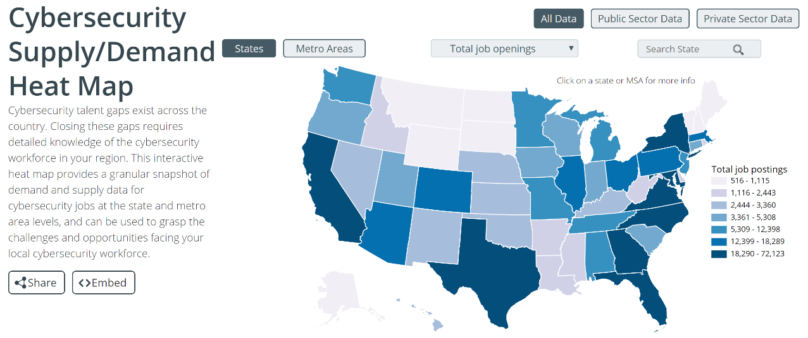
https://www.cyberseek.org/heatmap.html

Slide 31
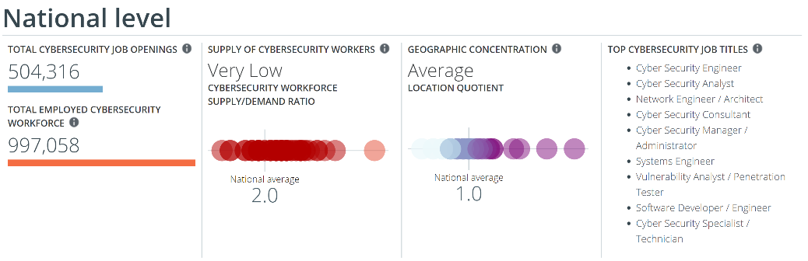
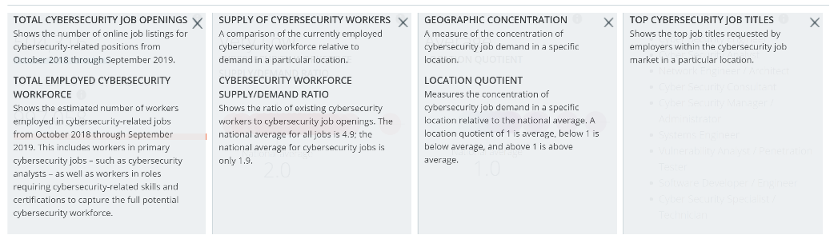

Slide 32
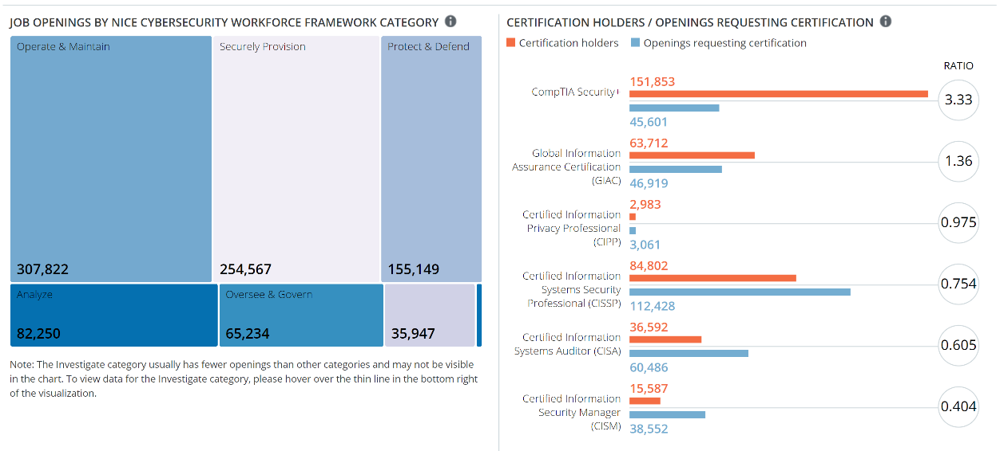

Slide 33


